Slide 1
Budget Project
Cliff Hudson
Billy Strother
Donnell Cannon
Caroline Linker
Keith Parker

Slide 2
School Mission and Vision
MISSION
Archer Lodge Middle School will inspire all learners as we nurture talents and interests while encouraging self-motivation and self-discipline. We will achieve academic success in a safe environment through belief in student potential and by establishing and building relationships while creating productive citizens for any community.
VISION
Archer Lodge Middle School will use school and community resources to create, educate, responsible, and productive citizens.

Slide 3
School Demographics

Slide 4
School Improvement Plan
Goal 1: All Johnston County School Facilities will provide a safe, clean, caring, orderly, and positive environment that supports and is conducive to Learning. (Organizational)
Goal 2: All Johnston County School students will demonstrate high level of character, academic growth and achievement. (Academic)
A 12% increase of all students will demonstrate proficiency on the reading EOG. Strategy: IRead Intervention & Enrichment

Slide 5
School Improvement Plan
Goal 3: All Johnston County Schools will provide the resources to meet the needs of all stakeholders (Organizational)
Collaborate to provide appropriate and differentiated instruction by 6/01/2016 as measured by student achievement. Strategy: PLC & Interactive PLC Notebooks
Goal 4: All Johnston County School leaders will encourage and promote family, community, and business involvement. (Organizational)

Slide 6
School Improvement Plan & Spending

Slide 7
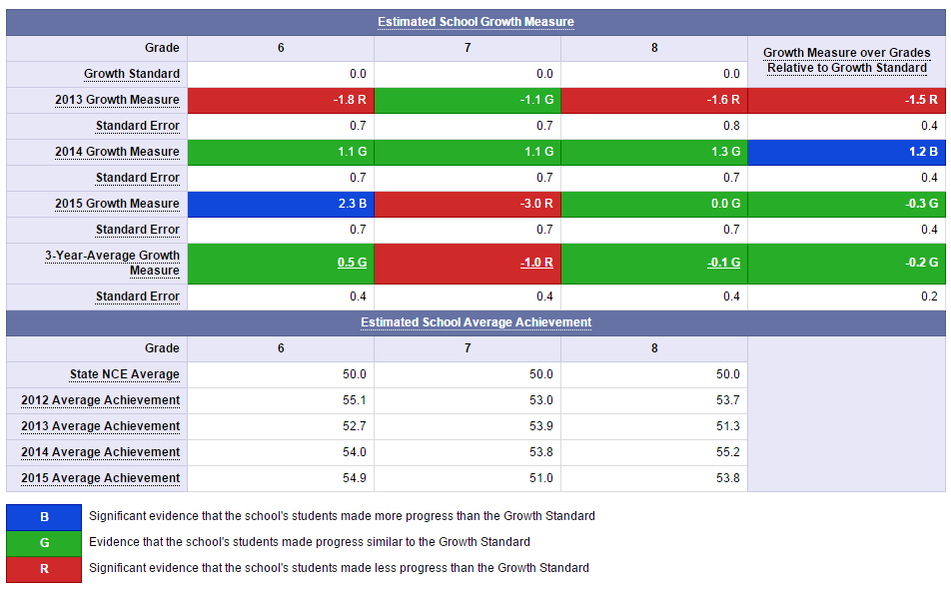
Testing Data

Slide 8
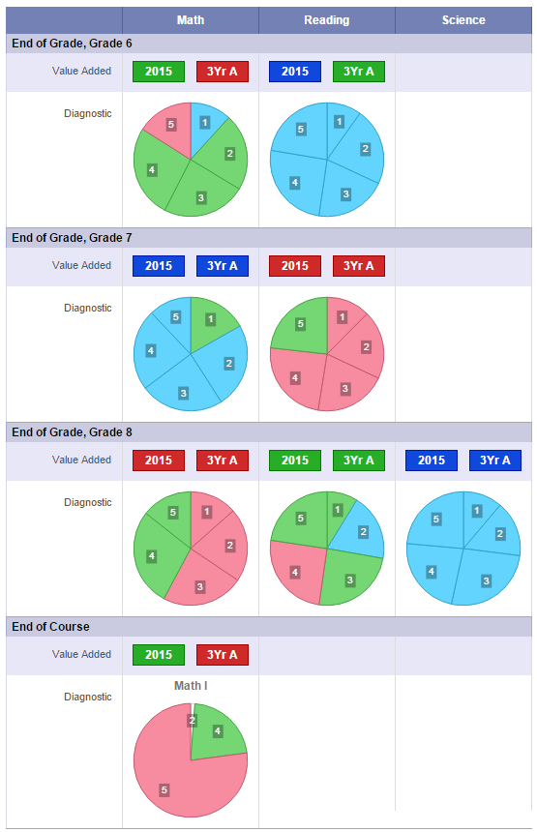
Testing Data

Slide 9
Perception Data
Discrepancies in Student Responses from 2014-2015
Purpose & Direction | Governance & Leadership | Teaching and Assessing Learning | Resources and Support Systems | Using Results for Continuous Improvement
1.67% | 1.99% | 0.60% | 3.17% | 1.69%

Slide 10
Perception Data
Discrepancies in Staff Responses from 2014-2015
Purpose & Direction | Governance & Leadership | Teaching and Assessing Learning | Resources and Support Systems | Using Results for Continuous Improvement
8.84% | 12.22% | 8.37% | 9.79% | 10.23%

Slide 11
TWC 2014-2015
Staff:
Likes | Fun environment, supportive staff, time for collaboration, opportunities for innovation, positive communication
Dislikes | Availability of technology, lack of curriculum resources, PLC notebooks, mobile units
Suggestions: | Increased feedback and differentiated opportunities for professional development, student choice in electives, effective communication, increased technology, more guidance for PLCs.

Slide 12
Perception Data
Discrepancies in Parent Responses from 2014-2015
Themes:
Communication/stakeholder involvement (purpose/goals)
Differentiation of instruction
Support services
Purpose & Direction | Governance & Leadership | Teaching and Assessing Learning | Resources and Support Systems | Using Results for Continuous Improvement
-0.37% | -2.50% | 1.92% | -0.11% | 0.89%

Slide 13
TWC 2014--2015
Parents:
Likes | Teachers, good communication (ConnectEd), caring and welcoming staff.
Dislikes | Drugs, Powerschool (grades) not updated frequently, office staff, lack of choice in electives,inconsistent communication, security.
Suggestions: | Re-evaluate open house processes, Remind 101 app schoolwide, more consistent updates of grades, provide student choice in electives.

Slide 14
Technology in School
Number of Devices in Use:
Administration | 13
Media | 12
Student | 848
Teacher | 88
Undefined | 0
Total: | 961

Slide 15
Technology in School
To meet the JCS Best Practice of a 20% technology refresh :
192 Devices for 20% Refresh
187 Priority Discard PCs ($86, 955)
4 Priority Discard Laptops
Estimated Costs: $ $61, 120 -- $115, 320

Slide 16
Previous Budgetary Spending
Beginning Budget:
Instructional Supplies: $38,677.00
Library Books: $3,147.00
State Equipment: $3,147.00
Teacher Travel $1,325.00
Administration Travel: $3,311.00
Non Capital Equipment: $8,549.00
Athletic Equipment: $4,000.00
Total: $62,156.00

Slide 17
Reflection on Concerns
Our primary concern is the significant decline in growth and proficiency with the 7th grade reading EOG scores.
We want to focus on helping the 7th grade ELA teachers and students through in house professional development, vertical PLCs, intervention strategies and reading resources.

Slide 18
Recommendations for Improvement
Vertically aligned PLCs with active involvement from administration to model PLC expectations-- “what is inspected gets respected.”
Intervention during IRead sessions
In house professional development with all reading teachers, to allow them to work on strategies that helped with student growth in reading in 6th & 8th grade. This will require substitutes for the reading teachers at $100 a day 5 from 7th grade and a lead 6th and 8th grade teacher. Total cost: $700 per session.

Slide 19
Recommendations for Improvement
4.) Hill Center for Literacy to provide staff development on reading in include, comprehension, vocabulary, and phonics. Staff development will run $1,500 along with 5 substitutes for 7th grade $100 each=$500 Total cost: $2,000
5.) During IRead we will implement the use of reading resources such as reading resources.net, and metametrics.inc which provide free online lexile scores and reading resources adapted to the students’ ability. We would like to provide training and time for successful implementation by providing substitutes for 5 7th grade teachers $100 each =$500 Total cost: $500 per session

Slide 20
Recommendations for Improvement
6.) Focus on direct vocabulary instruction.
7.) Professional development on Understanding By Design framework to allow teachers to think purposely about curricular planning, deepening student understanding of concepts and transfer of learning.

